Slide 1
PRESENTATION BY UGO BARDI

Slide 2
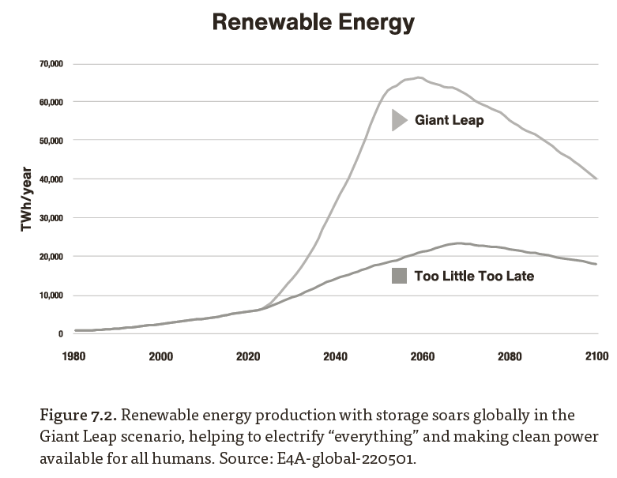

Slide 3
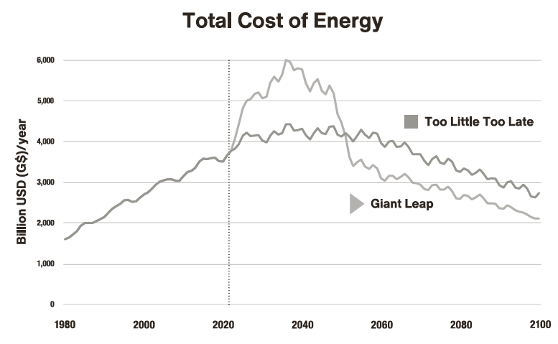

Slide 4
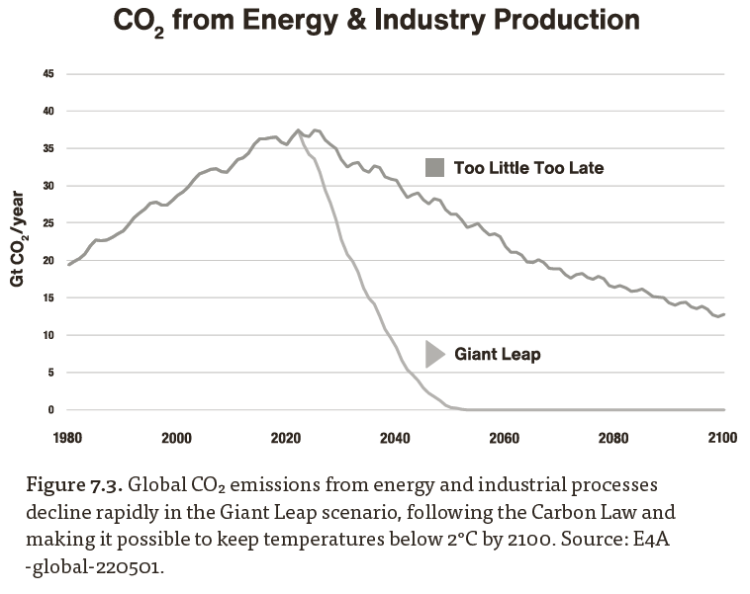

Slide 5
https://www.clubofrome.org
https://www.clubofrome.org

